Slide 1
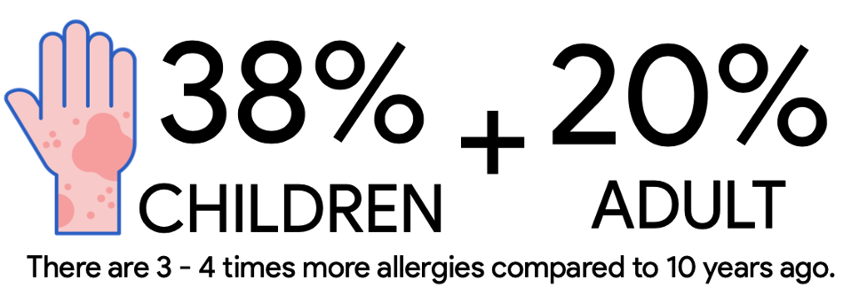
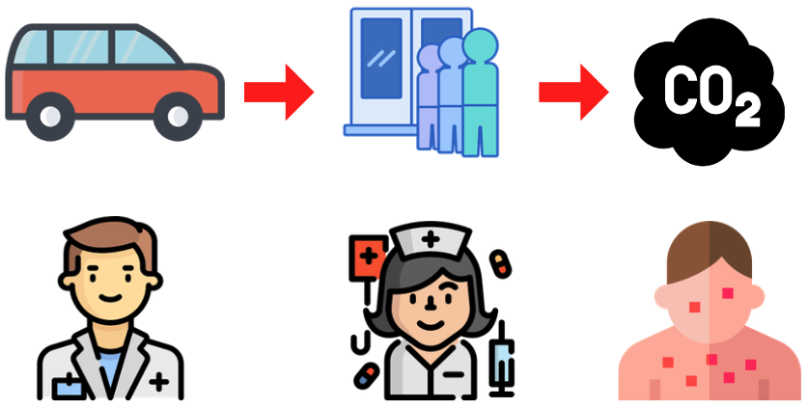

Slide 2
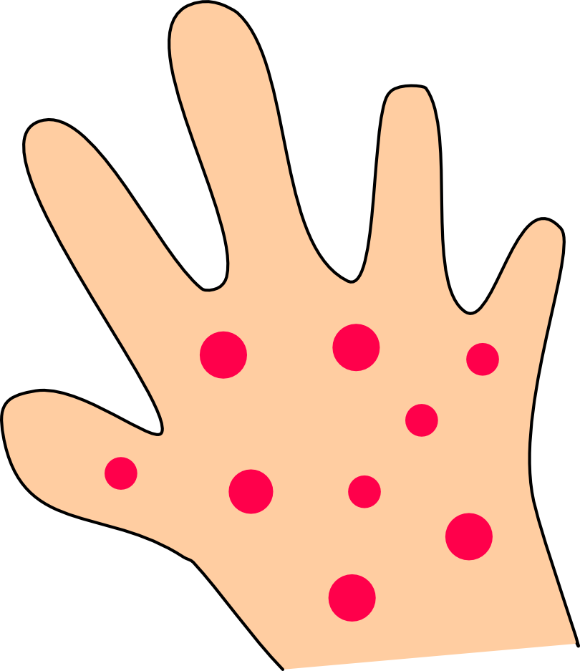

Slide 3

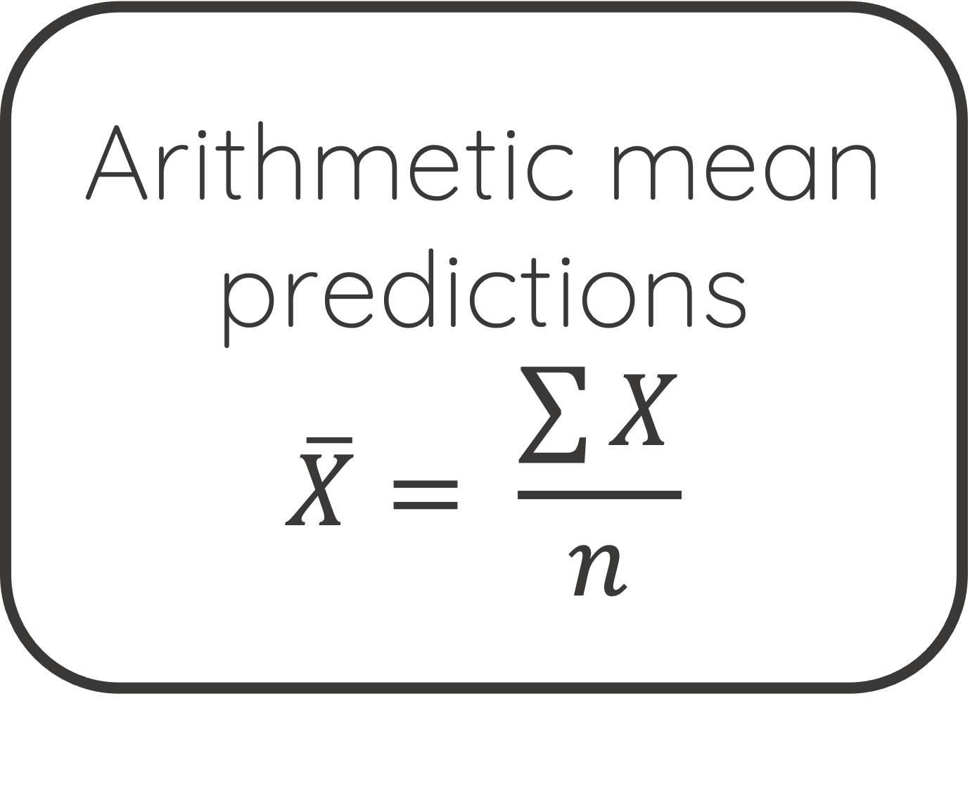
DenseNet121-PJ61403 Oversampling
utilization
model + weights
DenseNet121-PJ61403
Class Weights
adjustment
model + weights
Arithmetic mean predictions
$$\overline{X}= \frac{\sum{X}}{n}$$
Take or select photos of skin diseases you want to classify.
DenseNet121-PJ61403 Focal Loss implementation
model + weights
Wait for the analysis result with advice.

Slide 4
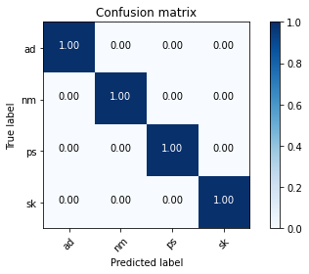
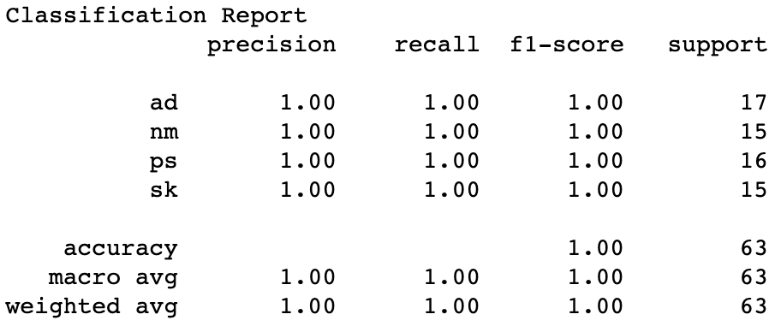
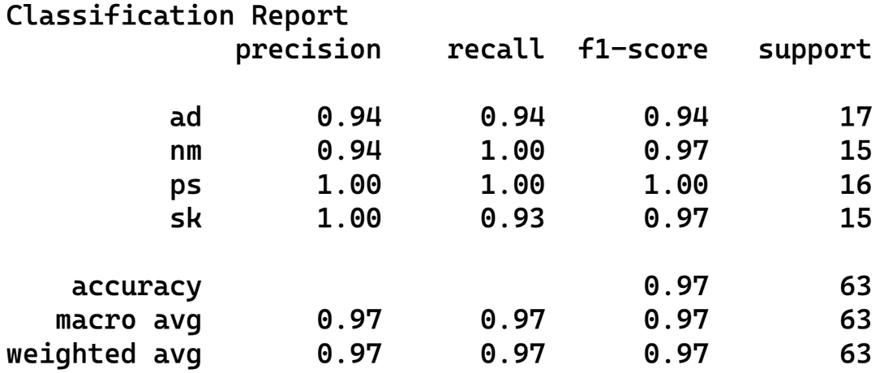

Slide 5
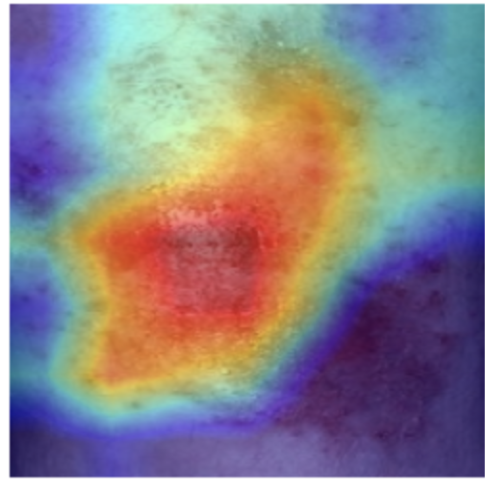
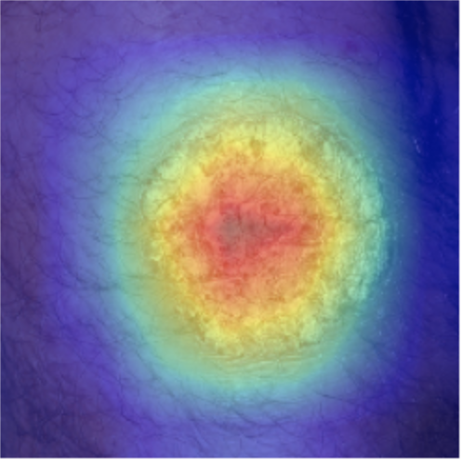
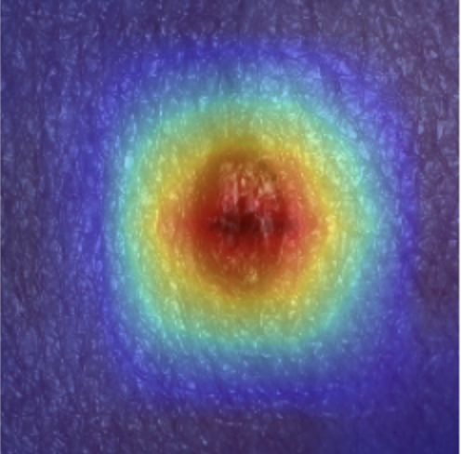
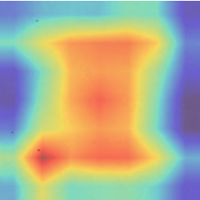
Atopic Dermatitis
(AD)
Psoriasis
(PS)
Seborrheic Keratosis (SK)
Normal Skin
(NM)

